Slide 1
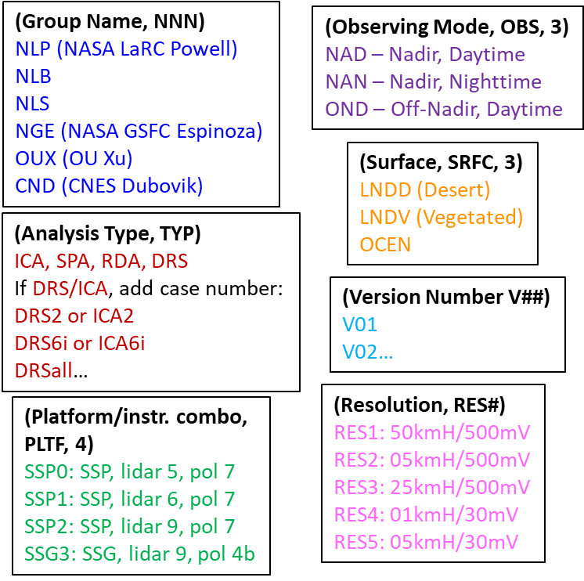
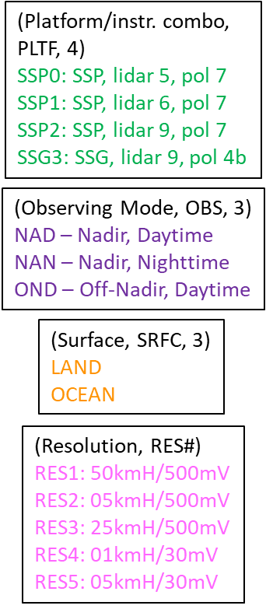
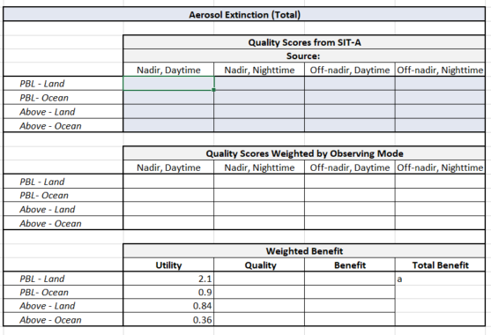
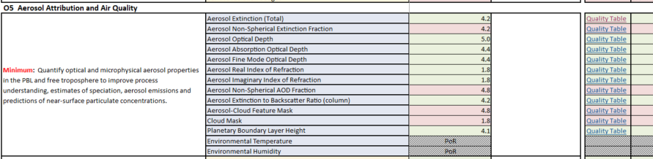
1.SIT-A Quality scores
15,000 .csv files
2.SIT-A Level 1 aggregation
3. SIT-A To VF
Output format: 4 files with “Adjusted Quality Scores”,
One for each platform/instrument combination
For one platform: | Nadir Daytime | Nadir Nighttime | Off-nadir, Daytime
AAOD UV PBL Ocean
AAOD UV PBL Land
AAOD UV Column Ocean
AAOD UV Column Land
AAOD VIS PBL Ocean
AAOD VIS PBL Land
AAOD VIS Column Ocean
AAOD VIS Column Land
+ all other GVs
For one platform: | Nadir Daytime | Nadir Nighttime | Off-nadir, Daytime
AAOD UV PBL Ocean
AAOD UV PBL Land
AAOD UV Column Ocean
AAOD UV Column Land
AAOD VIS PBL Ocean
AAOD VIS PBL Land
AAOD VIS Column Ocean
AAOD VIS Column Land
+ all other GVs
For one platform: | Nadir Daytime | Nadir Nighttime | Off-nadir, Daytime
AAOD UV PBL Ocean
AAOD UV PBL Land
AAOD UV Column Ocean
AAOD UV Column Land
AAOD VIS PBL Ocean
AAOD VIS PBL Land
AAOD VIS Column Ocean
AAOD VIS Column Land
+ all other GVs
Aggregation of:
Groups
Analysis Type
Land Surfaces
For one platform: | Nadir Daytime | Nadir Nighttime | Off-nadir, Daytime
AAOD UV PBL Ocean
AAOD UV PBL Land
AAOD UV Column Ocean
AAOD UV Column Land
AAOD VIS PBL Ocean
AAOD VIS PBL Land
AAOD VIS Column Ocean
AAOD VIS Column Land
+ all other GVs
SIT-A will determine which ones are the relevant resolutions and decrease # of Q scores shared
This will require averaging of the two land surface types
5. VF Quality Tables
6. VF Summary Scores
4. VF Matlab Script
Needs to work with format from SIT-A
Needs to aggregate UV, VIS, NIR
Produces tables similar to Q tables, with headers
Linked to Quality tables
Populated manually for 4 platforms

